Slide 1
Graphically Visualizing a Complex System with the Integration of Deep Learning Object Detection and Tracking
By Colin Henson and Bryce George

Slide 2
Background
Visualizing complex systems is difficult but useful
Allows for pattern recognition and understanding the mechanics of a system on a fundamental level
Success relies on the computer’s
Spatial and perspective awareness
Ability to detect objects of interest
Ability to re-identify objects between distinct frames

Slide 3
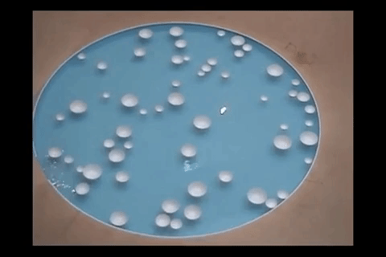
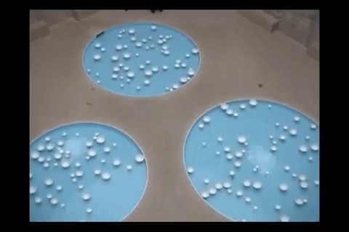
“Variation” by Céleste Boursier-Mougenot

Slide 4
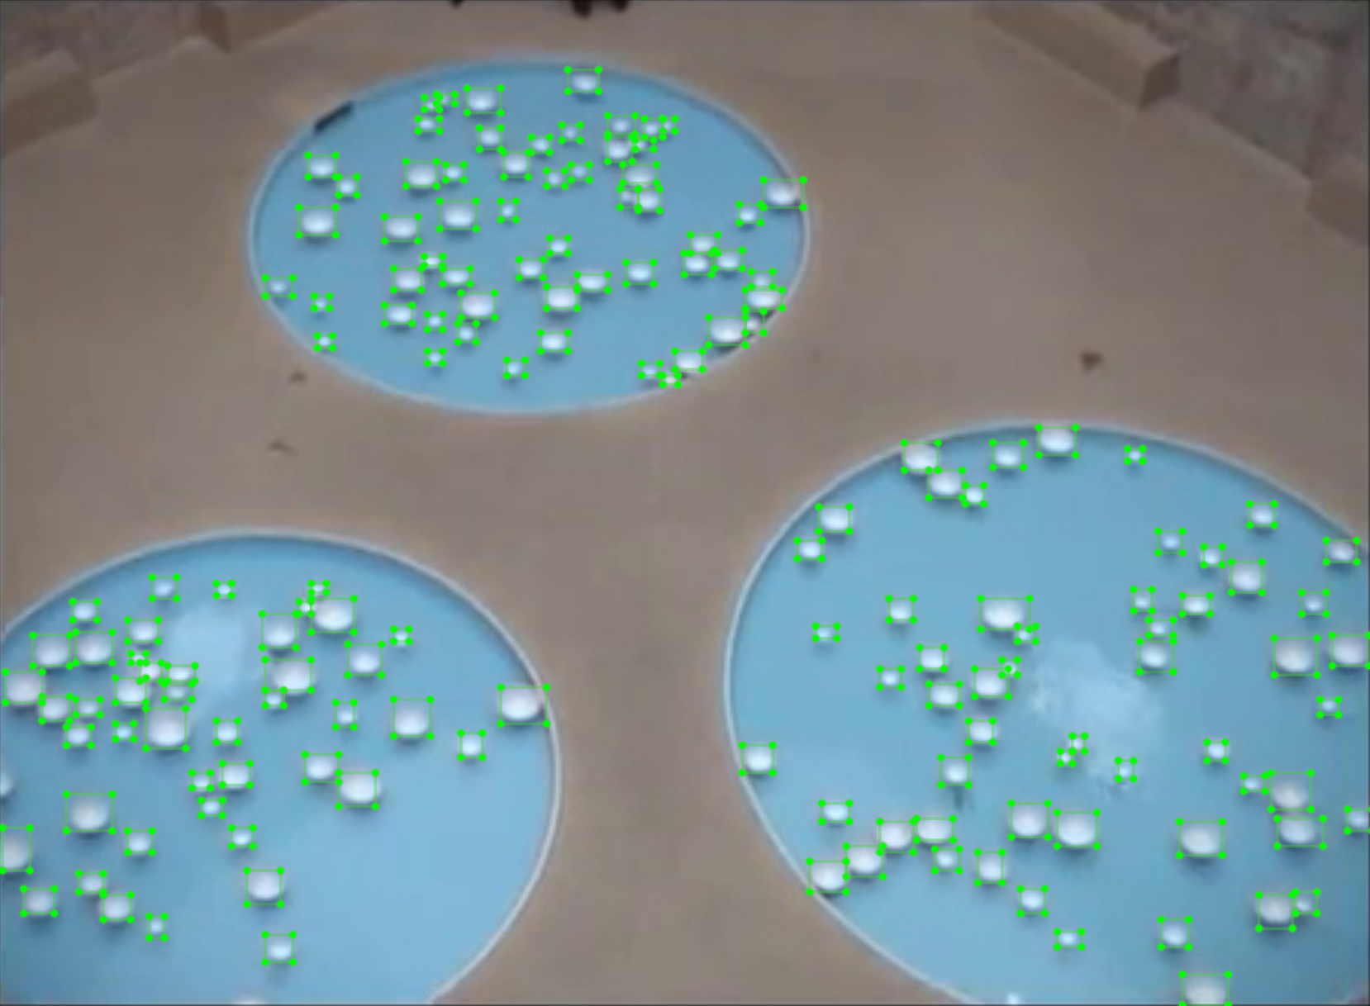
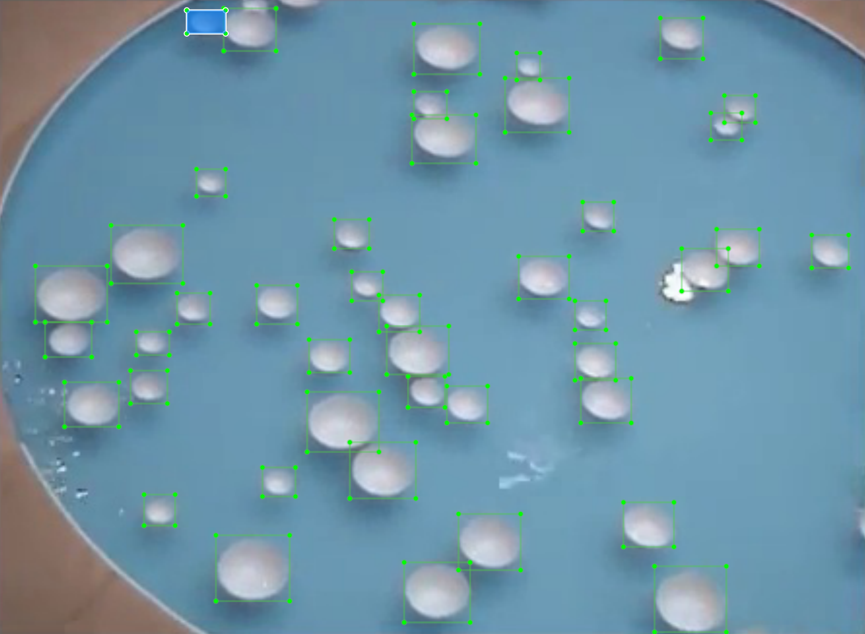
Methods: Object Detection
Sought Deep Learning object detection solution
Created a custom dataset for training a detector to identify bowls
Trained the detector using transfer learning from the YOLOv3 algorithm with the custom dataset

Slide 5
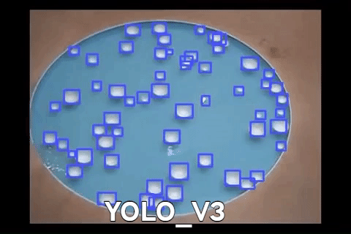
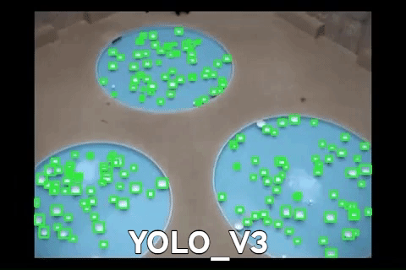
Results: Object Detection

Slide 6
Methods: Object Tracking
Sought Deep Learning object tracking solution
A number of existing trackers available, tested the following:
Kernelized Correlation Filters (KCF)
Generic Object Tracking Using Regression Networks (GOTURN)
Discriminative Correlation Filters with Channel and Spatial Reliability (CSRT)
CSRT performed the best in tests
Attach a CSRT tracker to each bowl and update with subsequent frames to track their motion

Slide 7
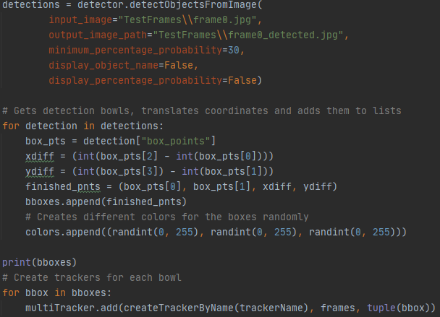
Methods: Integration
Run object detection on first frame
Initialize trackers for each object detected in the frame
Capture positions of tracked objects for subsequent frames
At a certain interval, re-run object detection on a tracked frame
Reconcile objects between tracking and detection
Identify objects that are the same
Add new objects which have come into scene
Remove objects which have left the scene
Repeat steps 2-5 for all remaining frames

Slide 8
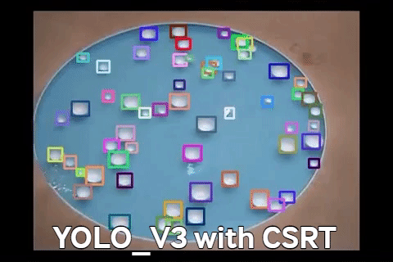
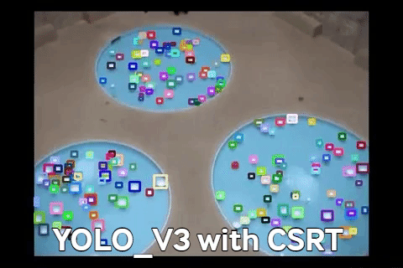
Results: Integration Prototype

Slide 9
Forthcoming Research: Visualization
Maintain path history for identified objects (position in each frame)
Render “trail” of each bowl in a unique color
Display dots at each of a bowl’s previous positions for the preceding n-frames
Dot size relative to recency
Stretch Goal:
Visualize harmonic patterns from collisions
Color flash corresponding with combination of objects’ trail colors
Update trail colors of affected objects after collision

Slide 10
Resources
Project Repository: https://github.com/ancient-sentinel/cs-4800-graphics-project
Recording of “Variations”: https://www.youtube.com/watch?v=mpwBbm22_y0

Slide 11
References
Lukezic, A., Vojír, T., Zajc, L.C., Matas, J., & Kristan, M. (2017). Discriminative Correlation Filter with Channel and Spatial Reliability. CVPR.
Olafenwa, Moses. ImageAI. 14 Jan. 2020, GitHub Repository, https://github.com/OlafenwaMoses/ImageAI
ImageAI Documentation Website: https://imageai.readthedocs.io/en/latest/index.html
Pinacoteca de Sao Paulo. (2009 September 12-2009 November 8). “Variations” by Céleste Boursier-Mougenot. Sao Paulo, Brazil.

